Slide 1
Funny animals

Slide 2
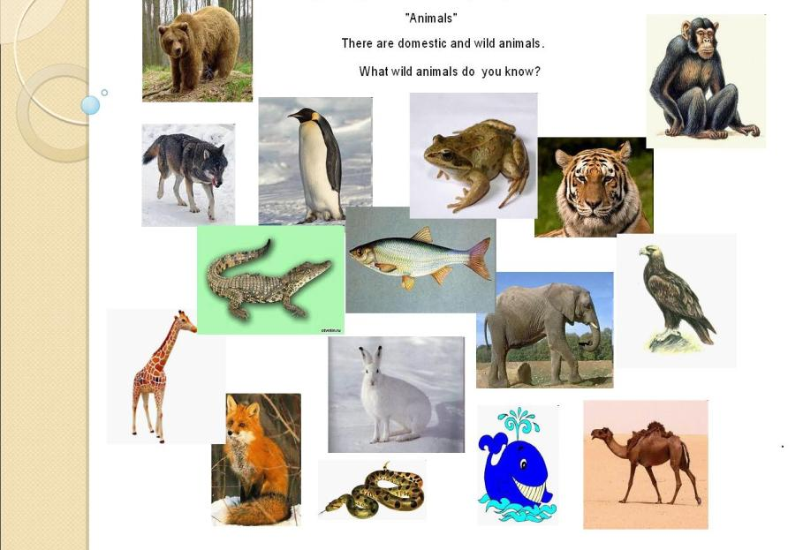
Zoo animals

Slide 3
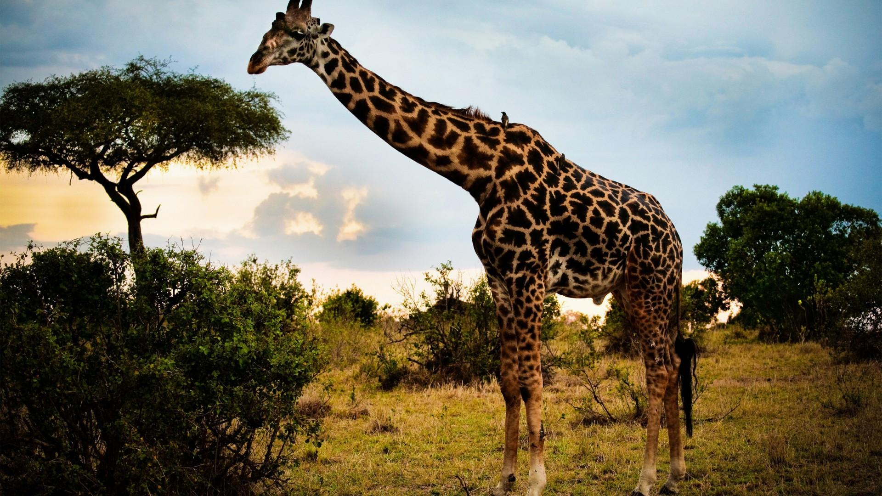
Giraffe is eating from a tree

Slide 4
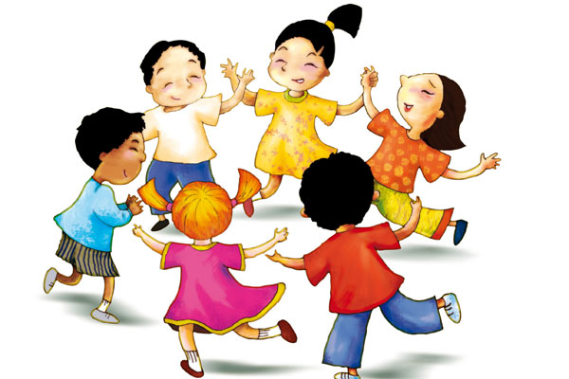
Let’s play

Slide 5
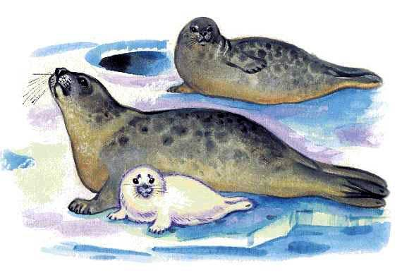
They’re seals

Slide 6
What animals can you see at the zoo?
Can you say what animals do at the zoo?
How good were you at the lesson?
Рефлексия

Slide 7

Goodbye!

